Slide 1


DHANALAKSHMI COLLEGE OF ENGINEERING
An Autonomous Institution, Affiliated to Anna University Chennai
DEPARTMENT OF ELECTRONICS & COMMUNICATION ENGINEERING
Smart Weather and Power Consumption Monitoring System with Real-Time Control Using MQTT.
Domain: Internet of Things
Guided by,
Mrs. Esther Gandhimathi M.E.,
Assistant Professor
Department of
Electronics and Communication Engineering
Team Members
Hemanth Kumar Nidhi (410721106026)
Yuvaraj E (410721106305)
Bharath J (410721106009)

Slide 2

Smart Weather and Power Consumption Monitoring System with Real Time Control Using MQTT
DHANALAKSHMI COLLEGE OF ENGINEERING.
ELECTRONICS AND COMMUNICATION ENGINEERING.

Slide 3
1.INRODUCTION
With the increasing demand for energy efficiency and environmental monitoring, smart systems integrating IoT provide a seamless solution.
This project focuses on a Smart Weather and Power Consumption Monitoring System using an ESP32, MQTT protocol, and various sensors to track environmental conditions and electrical usage in real time.
It also enables remote control of appliances, enhancing energy management.

Slide 4
2.OBJECTIVES
Monitor temperature, humidity, and power consumption in real time.
Provide remote control of electrical appliances via an MQTT-based app.
Display real-time data on a 20x4 LCD for local monitoring.
Ensure energy efficiency by tracking power consumption trends.
Store and transmit data efficiently using ESP32 and MQTT.

Slide 5
3.ABSTRACT
This project integrates ESP32, DHT22, PZEM-004T, and an MQTT-based control system to create a smart monitoring system. The DHT22 sensor measures environmental conditions, while the PZEM-004T module tracks voltage, current, power, and energy consumption. A 2-channel relay allows remote control of connected appliances. The system continuously updates the data to an MQTT server, enabling real-time monitoring via a mobile or web application. The 20x4 LCD provides local display for quick insights.

Slide 6
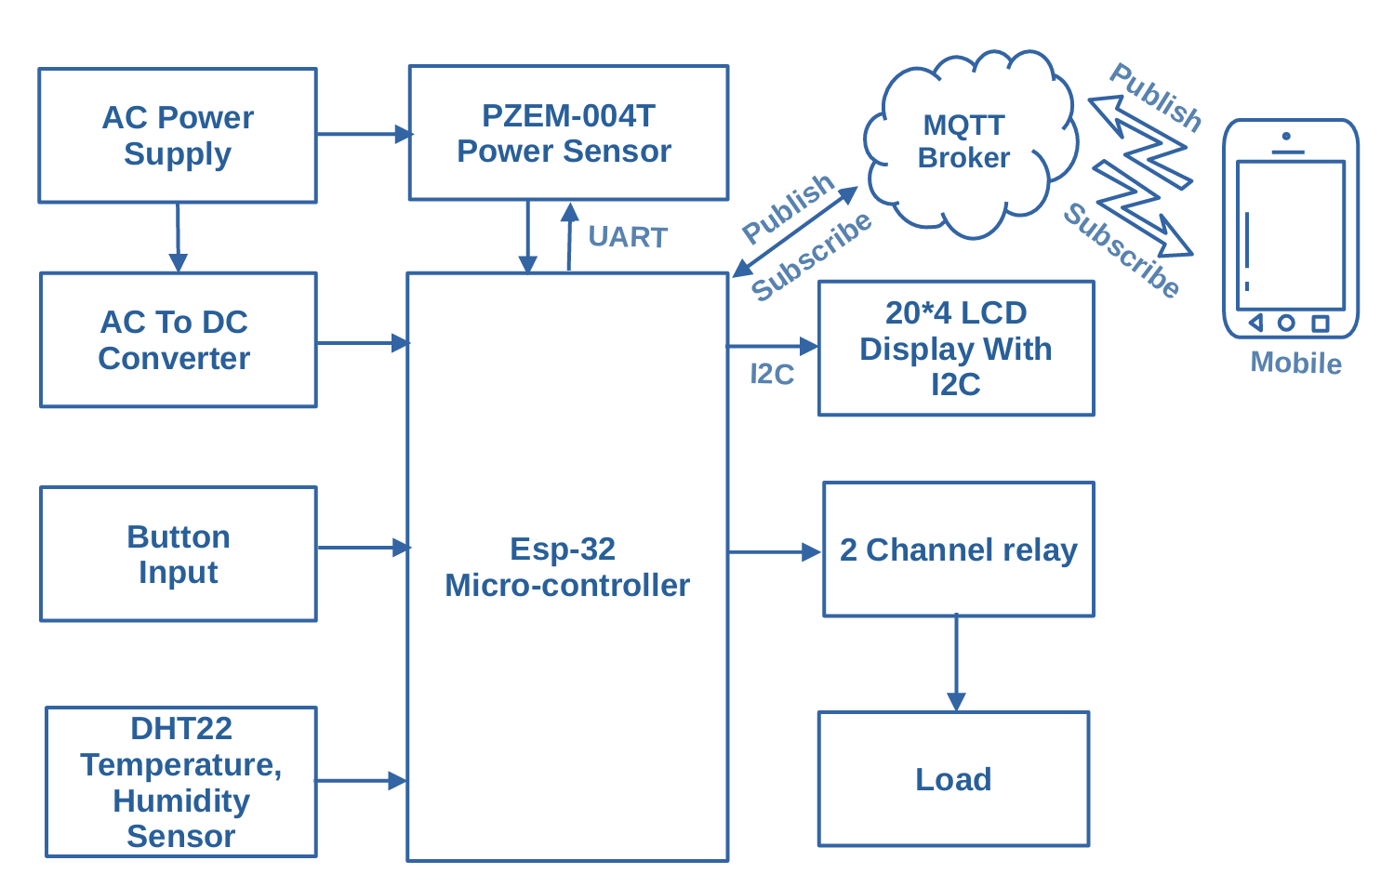
4.BLOCK DIAGRAM

Slide 7
5.COMPONENTS & BRIEF INTRODUCTION
ESP32 – Microcontroller with Wi-Fi & Bluetooth for IoT applications.
PZEM-004T – Measures voltage, current, power, and energy.
DHT22 – Digital temperature and humidity sensor.
2-Channel Relay Module – Controls electrical loads remotely.
20x4 LCD Display (I2C) – Displays real-time sensor readings.
MQTT Protocol – Facilitates real-time communication between devices and the cloud.

Slide 8
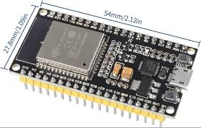
6.ESP32-WROOM
ESP32 – Wi-Fi & Bluetooth Microcontroller
ESP32 is a powerful microcontroller with built-in Wi-Fi and Bluetooth capabilities, making it ideal for IoT applications. It supports multiple sensors, low-power operation, and real-time data processing.
Features:
✅ Dual-core processor for efficient multitasking.
✅ Wi-Fi and Bluetooth connectivity for remote communication.
✅ Low power consumption with deep sleep mode.
✅ Multiple GPIOs to connect sensors, relays, and displays.
✅ Supports MQTT, HTTP, and WebSockets for cloud communication.

Slide 9
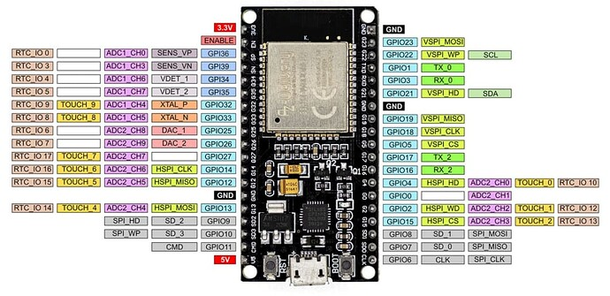
6.1.ESP32-WROOM
Specifications:
Processor: Dual-core Xtensa LX6 @ 240 MHz
Flash Memory: 4MB (varies by model)
GPIO Pins: 34 (Capable of PWM, ADC, I2C, SPI, UART)
Wi-Fi: 802.11 b/g/n (Station & AP mode)
Bluetooth: BLE & Classic
Operating Voltage: 3.3V
Current Consumption: ~160mA (active), ~10µA (deep sleep)

Slide 10
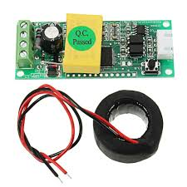
7.PZEM-004T
PZEM-004T – Power Monitoring Module
The PZEM-004T is an energy metering module designed to measure voltage, current, power, and energy consumption in AC circuits. It communicates via UART and is widely used for energy monitoring applications.
Features:
✅ Measures voltage (80-260V AC), current (0-100A), power, and energy.
✅ High accuracy measurement with minimal error.
✅ UART communication for easy integration with microcontrollers.
✅ Supports data storage to retain values after power loss.

Slide 11
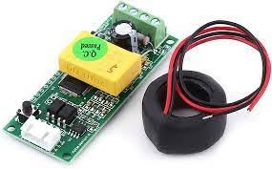
7.1.PZEM-004T
Specifications:
Operating Voltage: 80-260V AC
Current Range: 0-100A (via external CT sensor)
Power Measurement: 0-22kW
Energy Measurement: 0-9999kWh
Baud Rate: 9600bps (UART)
Accuracy: ±1%

Slide 12
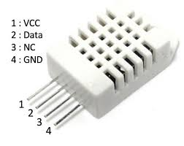
8.DHT22
DHT22 – Temperature & Humidity Sensor
The DHT22 is a digital sensor that provides precise temperature and humidity measurements, commonly used in weather monitoring and automation projects.
Features:
✅ Measures temperature (-40°C to 80°C) and humidity (0-100%).
✅ Calibrated output for high accuracy and stability.
✅ Single-wire communication for easy microcontroller integration.
✅ Low power consumption (ideal for battery-operated systems).

Slide 13
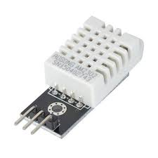
8.1.DHT22
Specifications:
Operating Voltage: 3.3V – 5V
Temperature Range: -40°C to 80°C (±0.5°C accuracy)
Humidity Range: 0-100% RH (±2% accuracy)
Response Time: 2 seconds
Output Signal: Digital (1-wire protocol)

Slide 14
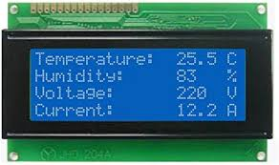
9.LCD Display (I2C)
20x4 LCD Display (I2C) – Real-time Data Display
This LCD screen provides clear, real-time data visualization, reducing the need for external displays like mobile or PC screens. The I2C module reduces wiring complexity.
Features:
✅ Displays up to 4 lines of 20 characters each.
✅ Uses I2C communication to reduce wiring.
✅ Compatible with 3.3V & 5V systems.
✅ Backlight for visibility in low-light environments.

Slide 15
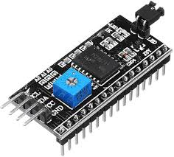
9.1.LCD Display (I2C)
Specifications:
Display Size: 20x4 characters
Interface: I2C (SDA, SCL)
Operating Voltage: 5V
Character Size: 2.95mm x 4.75mm
Backlight: LED

Slide 16
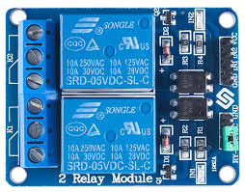
10.Relay Module
2-Channel Relay Module – Remote Load Control
This module is used to switch high-voltage electrical devices on or off using a low-voltage microcontroller signal, allowing remote automation.
Features:
✅ Controls AC (110V/220V) or DC loads up to 10A.
✅ Optocoupler isolation for safety and reliability.
✅ LED indicators for relay status.
✅ Low power consumption with a 5V trigger voltage

Slide 17
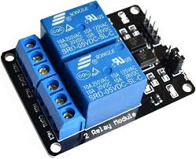
10.1.Relay Module
Specifications:
Operating Voltage: 5V
Trigger Voltage: 3.3V – 5V (compatible with ESP32)
Relay Switching Capacity: AC 250V/10A, DC 30V/10A
Number of Relays: 2
Optocoupler Isolation: Yes

Slide 18

11.MQTT
MQTT Protocol – IoT Communication
MQTT (Message Queuing Telemetry Transport) is a lightweight protocol used for real-time messaging between devices over the Internet or local networks.
Features:
✅ Low bandwidth consumption, ideal for IoT applications.
✅ Supports multiple devices via Publish/Subscribe architecture.
✅ Real-time data transmission with minimal latency.
✅ Secure communication using authentication and encryption.

Slide 19
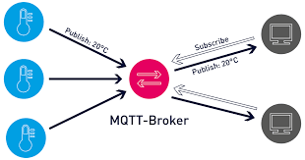
11.1.MQTT
Specifications:
Protocol Type: Publish-Subscribe
Transport: TCP/IP
Message Format: JSON, Binary, or Plain Text
Security: TLS/SSL support
QoS Levels: 0 (At most once), 1 (At least once), 2 (Exactly once)

Slide 20
12.PROBLEM STATEMENT & SOLUTION
Problem:
Lack of efficient monitoring leads to energy wastage and high electricity bills.
Manual tracking of power usage is inconvenient and inaccurate.
No remote-control system to optimize appliance usage.
Solution:
A real-time power monitoring system that logs and analyzes energy consumption.
Wireless control of appliances using an MQTT-based mobile app.
A user-friendly LCD display for local insights.

Slide 21
13.FEATURES
✅ Real-time monitoring of weather and power parameters.
✅ Remote appliance control via MQTT.
✅ Energy consumption tracking to optimize power usage.
✅ Live data display on LCD for quick insights.
✅ MQTT-based notifications and alerts for power fluctuations.

Slide 22
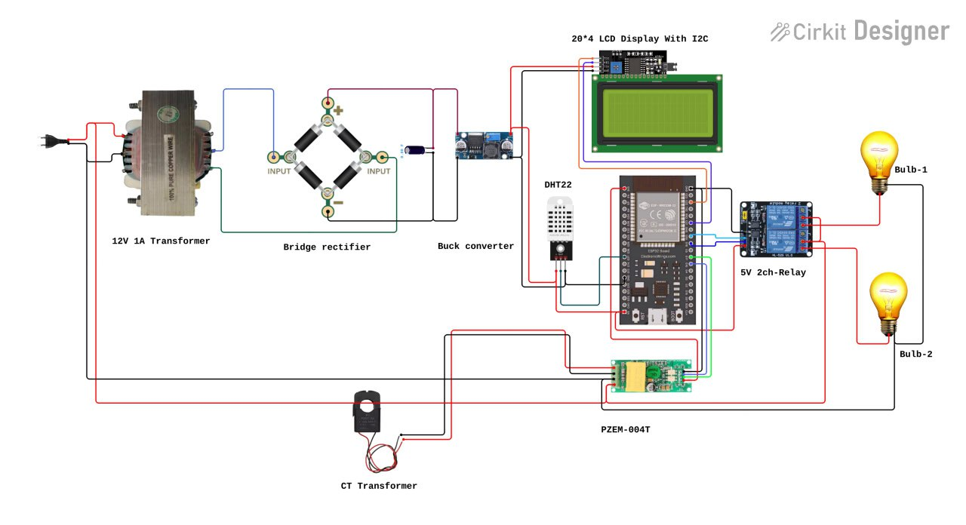
14 CIRCUIT DIAGRAM

Slide 23
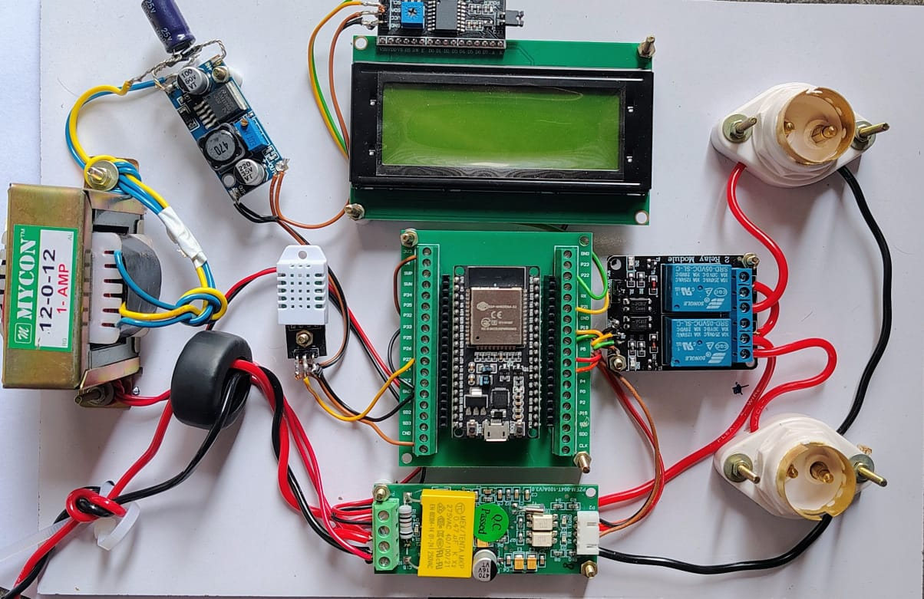
14 PROJECT LAYOUT

Slide 24
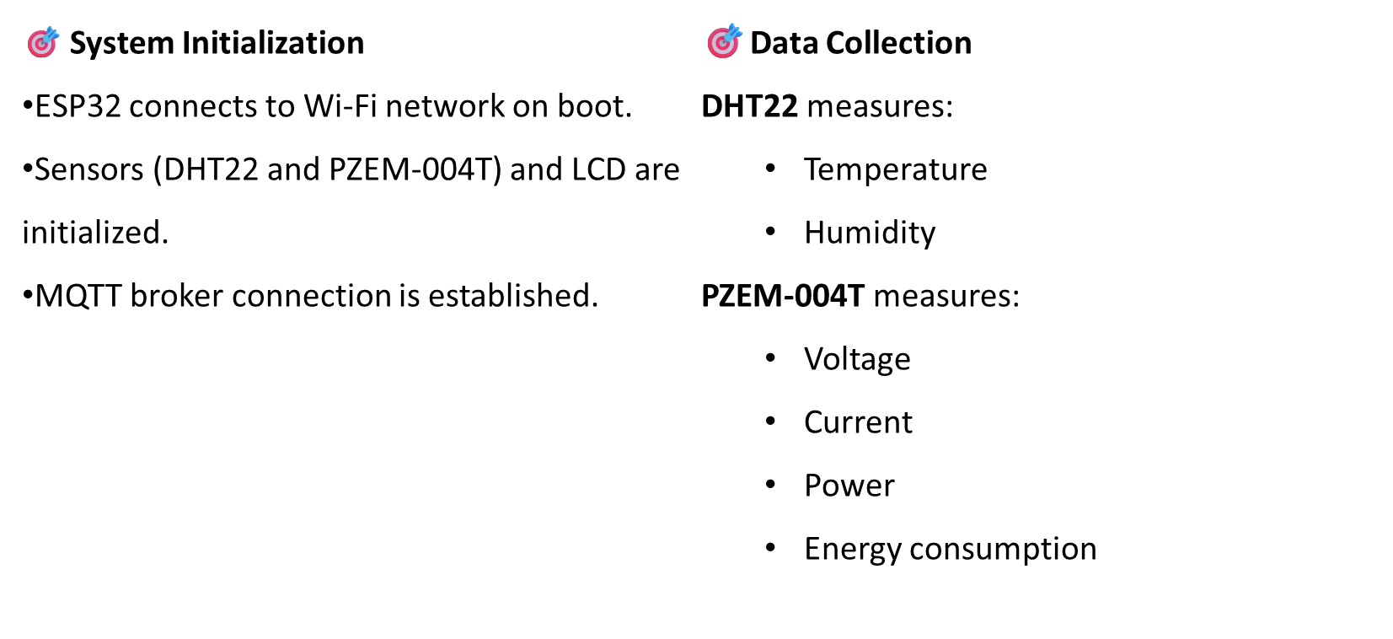
WORKING

Slide 25
WORKING
🎯. Data Display & Transmission
Sensor data is:
  Shown in real-time on 20x4 I2C LCD
  Published to MQTT broker under specific topics
🎯 Mobile Monitoring
MQTT Panel App subscribes to the same topics.
Displays real-time sensor data.
Uses toggle switches for appliance control.

Slide 26
WORKING
🎯 Real-Time Control
MQTT commands (ON/OFF) sent from the app.
ESP32 receives commands via subscribed topics.
2-Channel Relay triggers the respective appliances.
🎯 Continuous Monitoring & Control
Loop continues:
  Data updates every 2–5 seconds.
  Appliances can be remotely turned ON/OFF anytime.
Enables smart control and energy optimization.

Slide 27
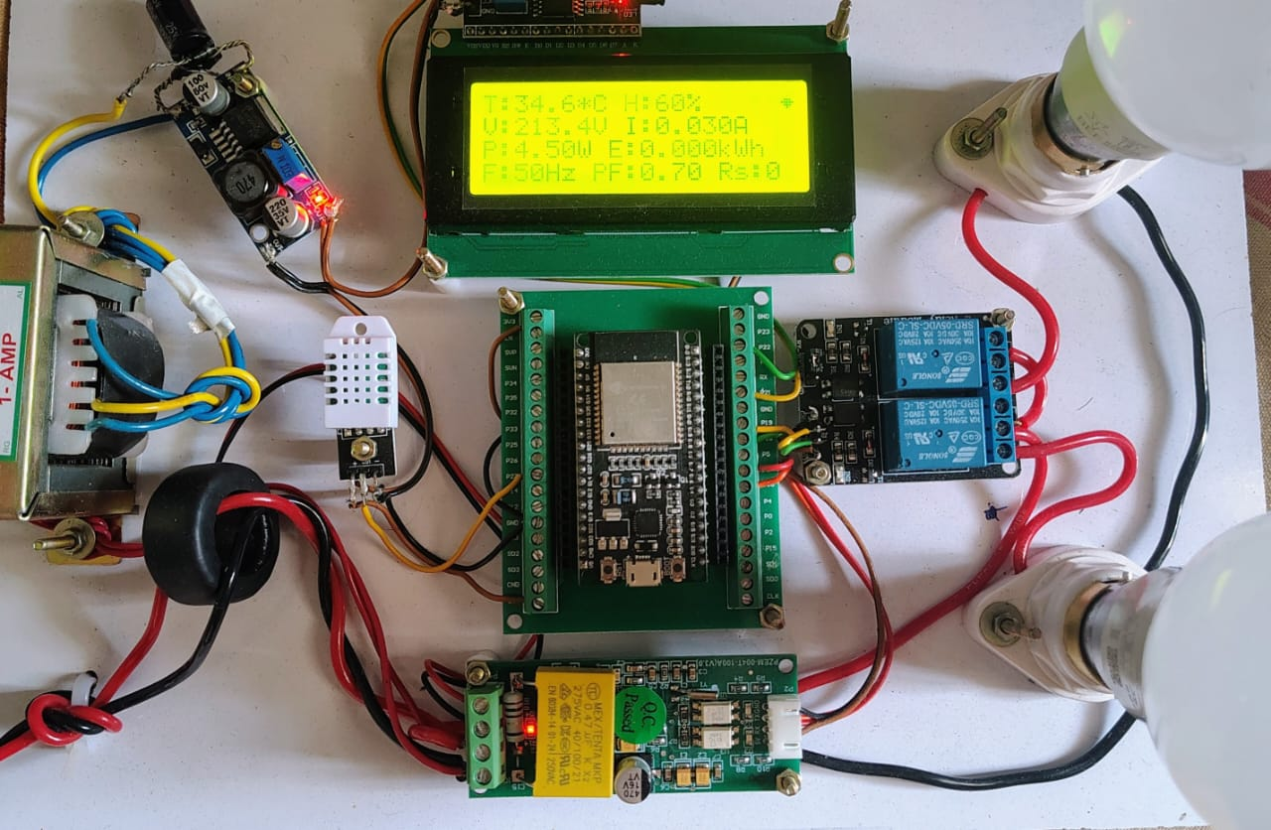
WORKING
✅ Outcome
Seamless integration of monitoring + control.
Real-time, wireless, low-latency communication.
Suitable for energy-aware smart home environments.

Slide 28
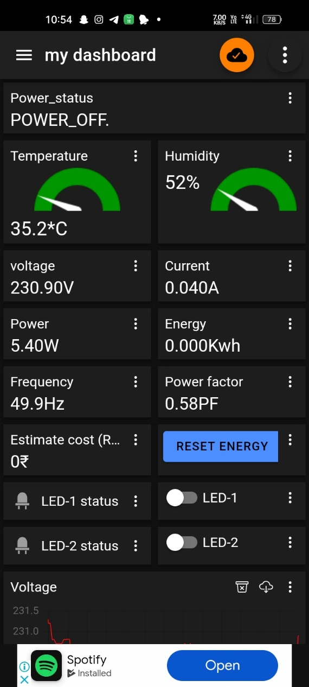
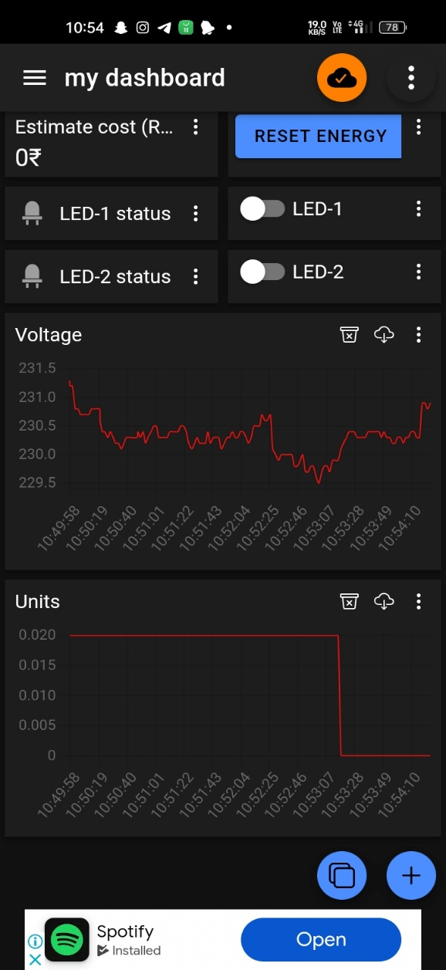
MQTT PANNEL INTERFACE

Slide 29
15.CONCLUSION
This system provides an efficient, real-time, and remote monitoring solution for power and weather parameters. By integrating IoT, MQTT, and ESP32, users can track electricity usage, automate control, and reduce wastage, leading to cost savings and smarter energy management.

Slide 30


16. REFERENCES & ACKNOWLEDGMENTS
References
Research papers, articles, and documentation.
Websites used for coding & circuit design.
Acknowledgments
Project Guide.
Mrs Esther Gandhimathi S
Batch members.
Yuvaraj E
Hemath Kumar Nidhi R
Bharath J

